Slide 1

Chat Verse Web Application Presented by Anurag Mahada (20210801070) Umesh Patil (20210801109) Vikram Jadhav (20210801133) Guided by Ms. Shobhana Patil School of Computer Science, Engineering and Application D Y Patil International University, Akurdi, Pune

Slide 2
Contents
1
2
3
4
5
6
INTRODUCTION
FLOWCHART
DFD
ERD DIAGRAM
SEQUENCE DIAGRAM
ACTIVITY DIAGRAM
7
CLASS DIAGRAM
8
DECISION TREE & DECISION TABLE
9
PSEUDO CODE

Slide 3
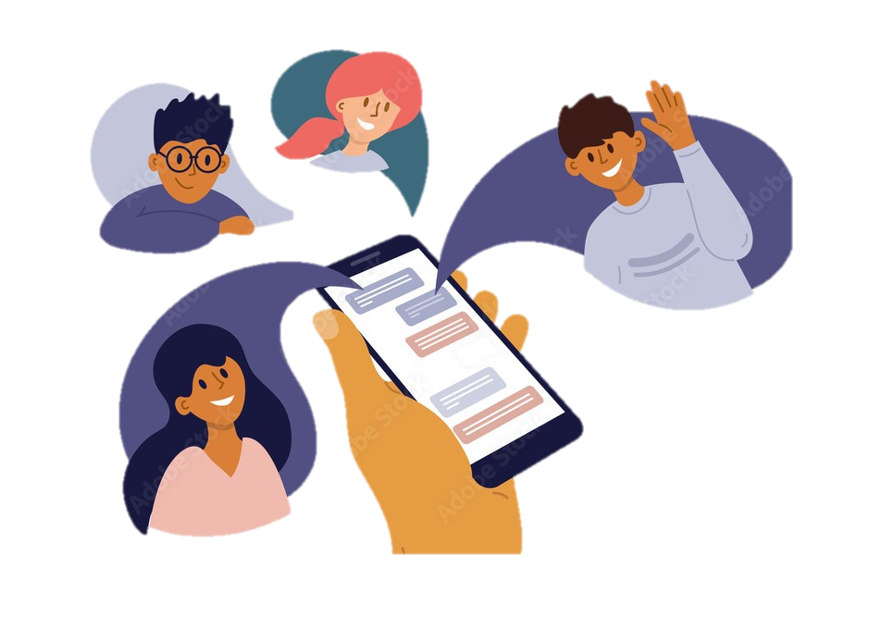
Introduction
The chat application is a platform designed for seamless communication and collaboration.
This real-time chat application offers a variety of features, including authentication, real-time chat, real-time notifications, typing indicators, guest login, group chats, one-on-one chats, and more.
The purpose of the chat application is to enhance communication efficiency and faster collaboration among users.

Slide 4
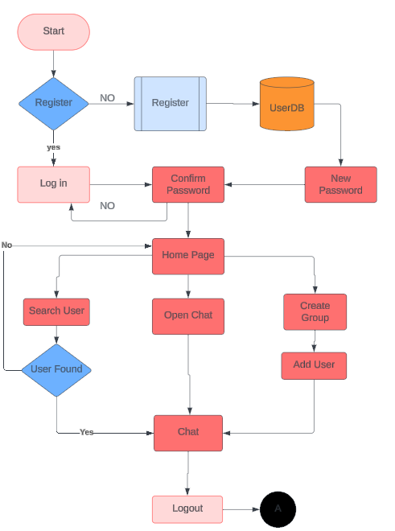
FLOWCHART

Slide 5
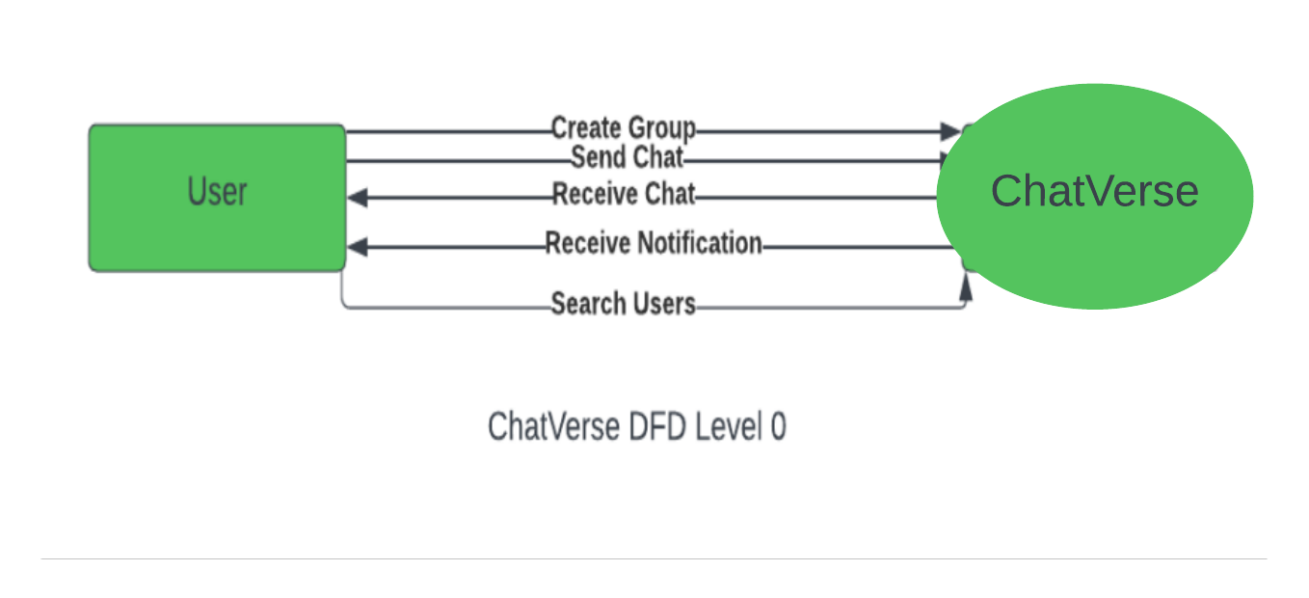
Data flow Diagram (DFD)
Level (0 Level) DFD

Slide 6
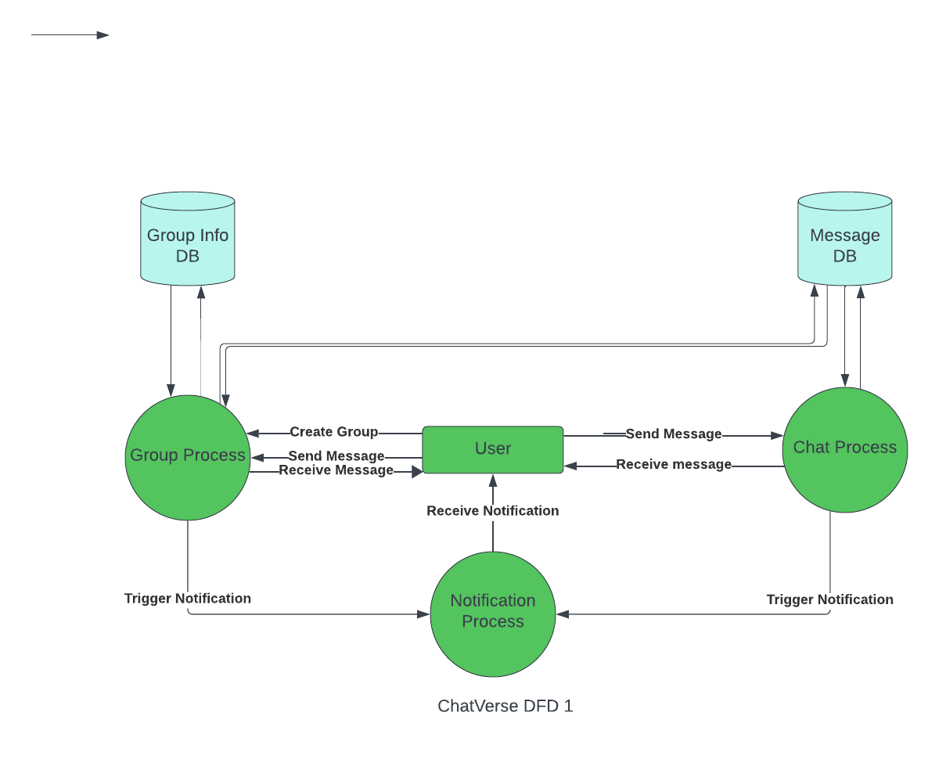
Level 1 DFD

Slide 7
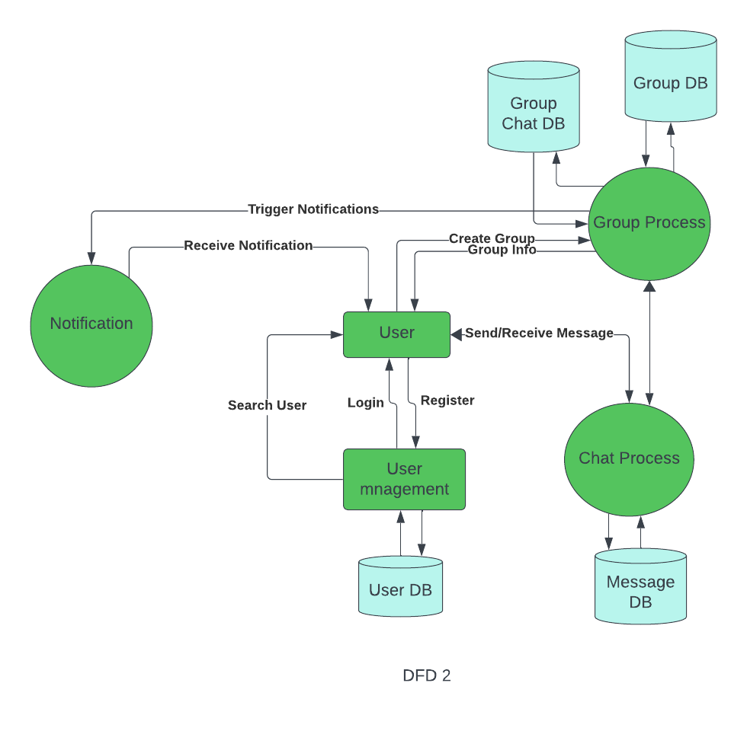
Level 2 DFD

Slide 8
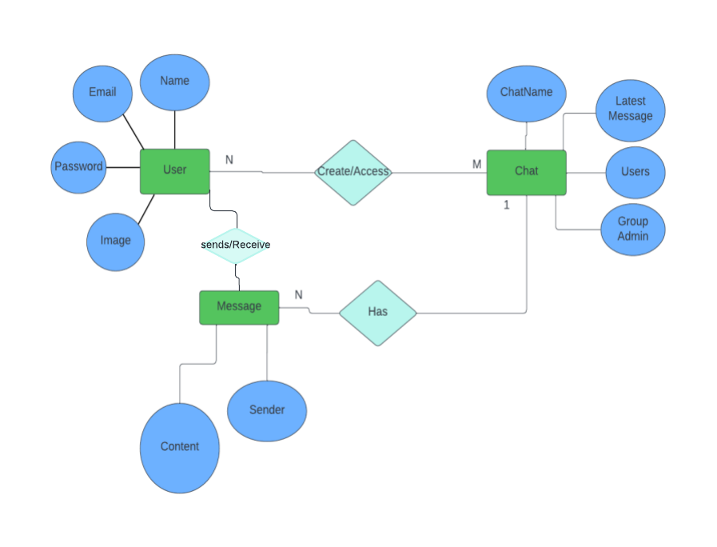
Entity Relationship Diagram

Slide 9
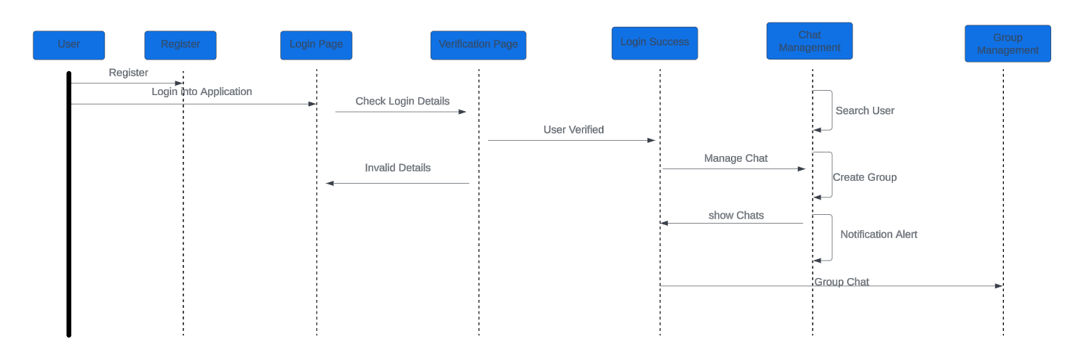
Sequence Diagram

Slide 10
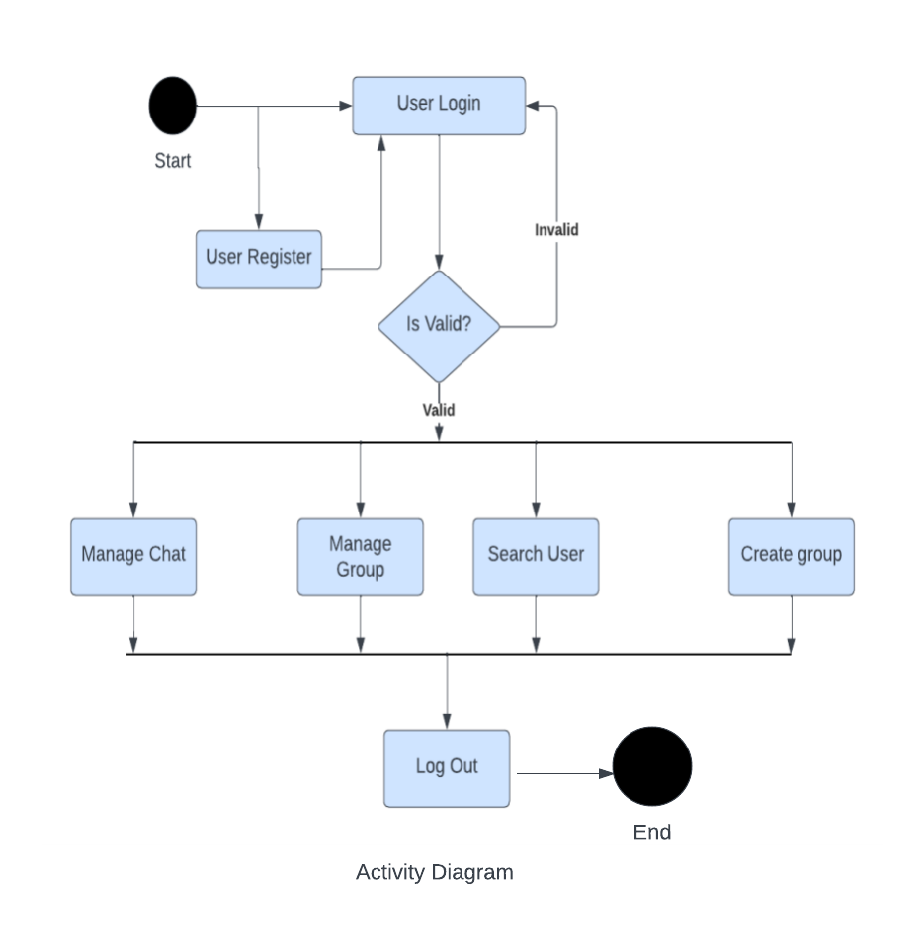
Activity Diagram

Slide 11
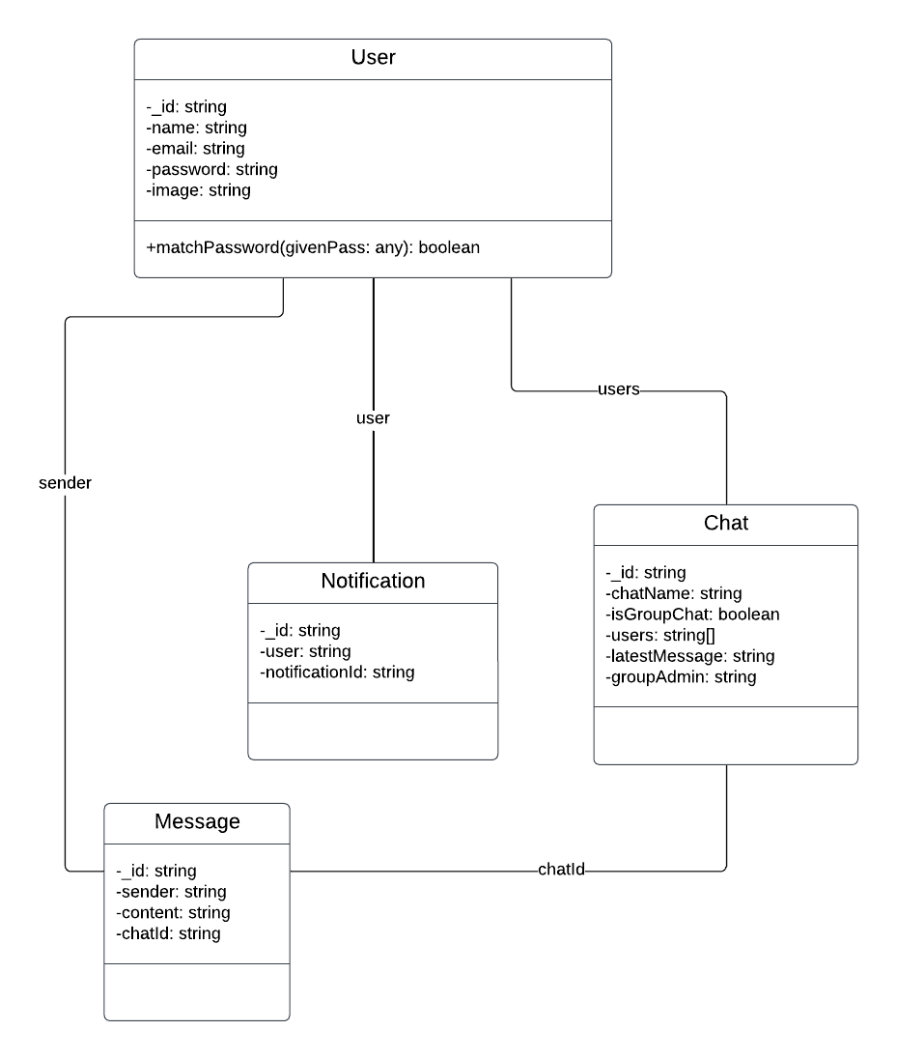
CLASS DIAGRAM

Slide 12
DECISION TABLE
Condition | 1 | 2 | 3 | 4
User id | F | T | F | T
Password | F | F | T | T
Action
Login to | Access | Access | Access | Access
Denied | Denied | Denied | Denied | Granted
Manage chat | NO | NO | NO | YES
Manage group chats | NO | NO | NO | YES
Receive Notification | NO | NO | NO | YES
Search Users | NO | NO | NO | YES
T: TRUE F: FALSE

Slide 13
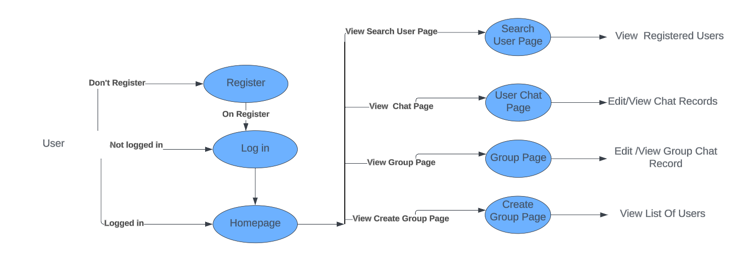
DECISION TREE

Slide 14
Pseudocode
#Pseudocode for Chatverse
#UserAuthentication Functions
function login(userCredentials):
#Authenticate the user using mongodb if authenticationSuccessful:
currentUser = getUserInfo(userCredentials) showHomePage()
else:
showErrorMessage()
function logout():
# user loggedout
function getUserInfo(userCredentials):
#Retrieve user information from Database

Slide 15
#HOME PAGE FUNCTIONS function showHomePage(): Function Chat(): #Fetch a chat Record from Database return chats function displaychats(chats): #Display a list of chats on the home page for each User friend #group Creation Funtions function creategroup(users): #Create a new Gorup in Database if GroupCreatedSuccessfully: showHomePage() else: showErrorMessage() #Group Details Functions function GroupDetails(users): Displaychats(chats)

Slide 16
SEND CHAT FUNCTIONS
function sendchat(Message){
if messageSendSuccesfully:
receiveResponce(message)
else:
showErrorMessage()
}
function receiveResponce(message):
return response;

Slide 17
#Profile Page Functions function
viewProfile(user): displayUserProfile(user)
function displayUserProfile(user):
# Display user's profile information
#Main Application
function main():
if userIsLoggedIn(): showHomePage()
else:
promptUserToLogIn()
main()

Slide 18
Thank YOU

